Slide 1
Handwriting Recognition for Genealogical Records
FHT 2003
Luke Hutchison
lukeh@email.byu.edu

Slide 2
Church Extraction Effort
Nov 2002: Church released US 1880 and Canadian 1881 Census
55 million names
11 million man-hours
Granite Vault: contains 2.3 million rolls of microfilm
( = about 6 million 300-page volumes )
Approximate extraction time for one person
(based on the above census): 280 years, 24/7
We don't have that sort of time
Need automated extraction: handwriting recognition

Slide 3
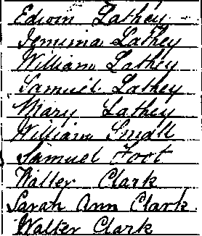
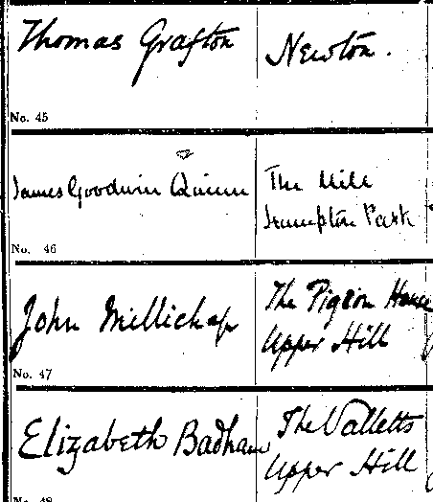
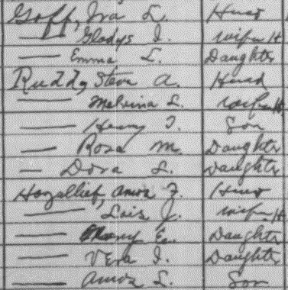
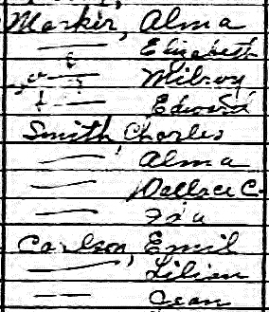
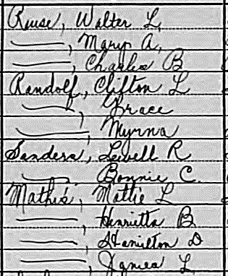
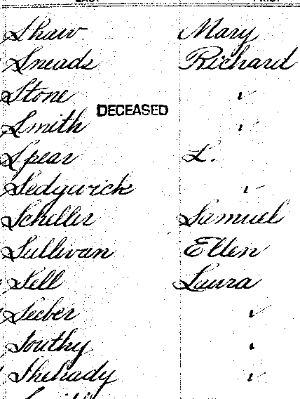
Example Microfilm Images

Slide 4


Handwriting Recognition
Two different fields:
  Online Handwriting Recognition
    Writer's pen movements captured
    Velocity, acceleration, stroke order etc.
    Style can be constrained (e.g. Graffitti gestures)
  Offline Handwriting Recognition
    Only pixels
    Cannot constrain style (documents
    already written)
Offline is harder (less information)
Genealogical records are all offline
Mary

Slide 5
Online Handwriting Recognition
Modern systems are moderately successful,
e.g. Microsoft Research's new Tablet PC:
Polynomial coefficients e.g. [0.94, 0.05, 0.29,...]

Slide 6
Offline Handwriting Recognition
A difficult problem
Almost as many approaches as there are researchers
e.g.
  Pattern Recognition
  Statistical analysis
  Mathematical modelling
  Physics-based modelling
  Subgraph matching / graph search
  Neural networks / machine learning
  Fractal image compression
  ... (too many to list) ...

Slide 7

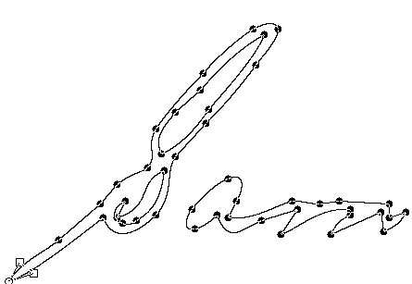
Previous Work: Offline→Online Conversion
  Finding contour
  Finding midline
  Stroke ordering – difficult problem

Slide 8



Offline→Online Conversion ctd.
Especially difficult with genealogical records:
  Stroke ordering: difficult
  Broken lines / blobs?
Not practical

Slide 9

Previous Work: Holistic Matching
Whole word is stretched to match known words
Sources of variation compound across word

Slide 10
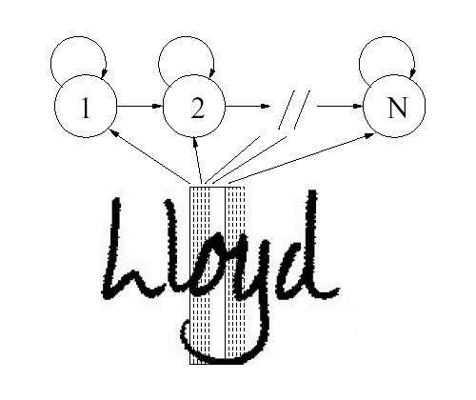
Previous Work: Sliding Window
Narrow vertical window slides across word
A state machine recognizes sequences
Results good, but sensitive to noise

Slide 11
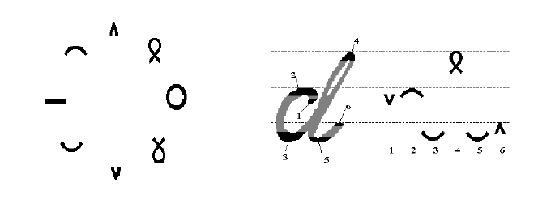
Previous Work: Parascript
Features detected & put in sequence
Letters warped to best match sequence of features
Complex; sensitive to noise

Slide 12

Handwriting Recognition
Some aspects of Handwriting Recognition:
  Segmentation problem
  (can't read word until
  it is segmented; can't
  segment word until it is read)
  Different handwriting styles
  Use of dictionary to correct
  for errors in reading
nr?
m?
Srnitb --> Smith

Slide 13



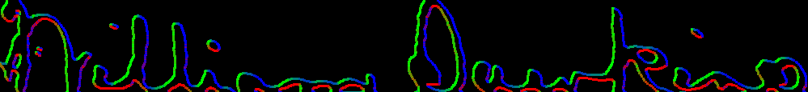
Thesis Approach: Preprocessing
Outlines of word are traced and smoothed:
Handwriting slope is corrected for automatically:

Slide 14
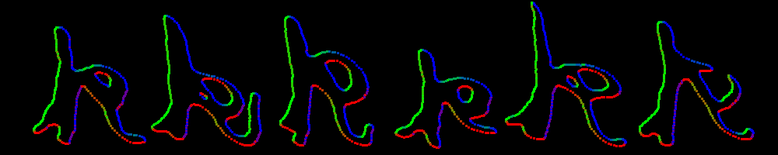
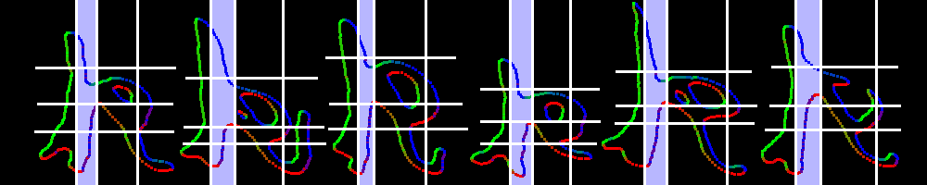
Segmentation
Goal: robustly cut letters into segments
Match multiple segments to detect letters
Easier than matching whole letter

Slide 15
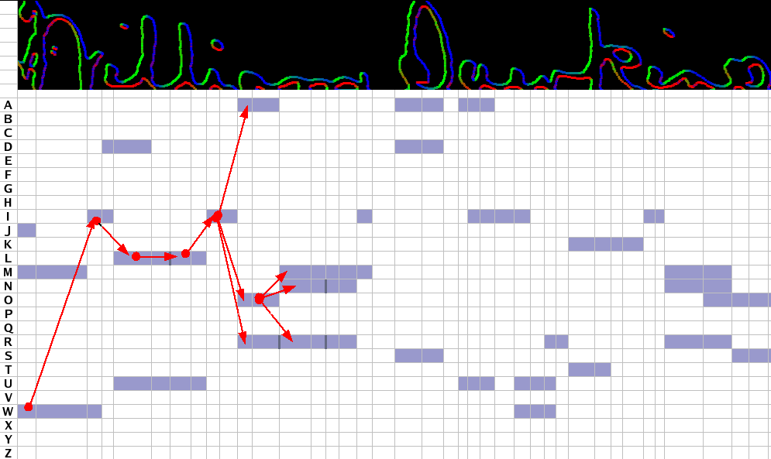
Dynamic Global Search
Assemble word spelling from possible letter readings
Best path: “Williarw Suwkino” (65% confidence)

Slide 16
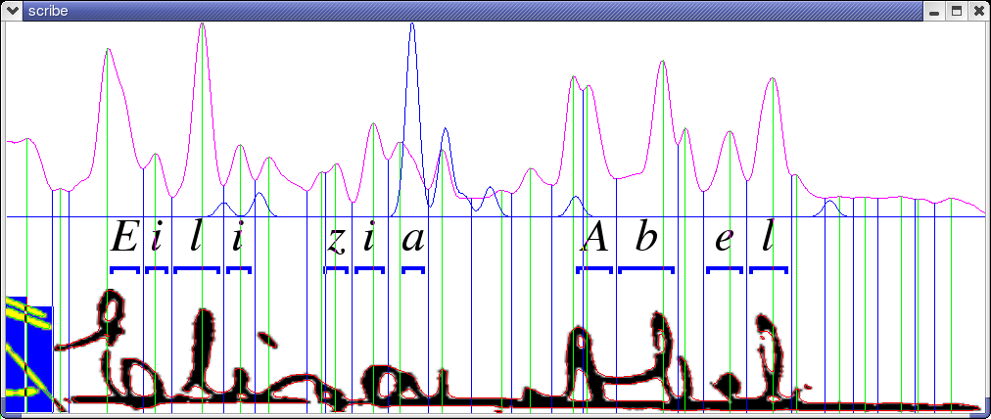
Results (1)

Slide 17
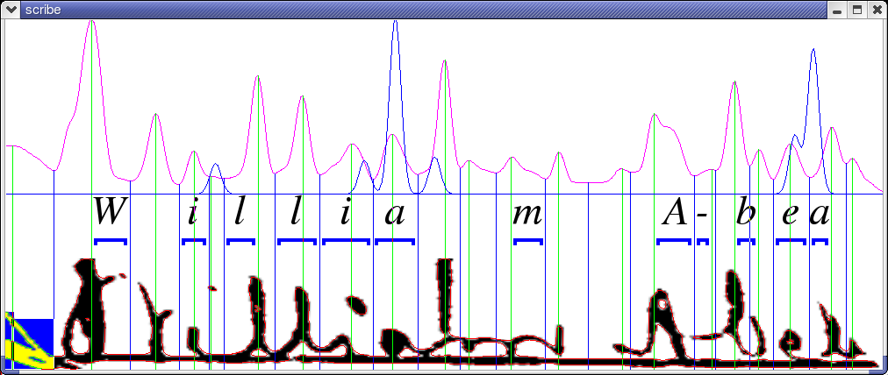
Results (2)

Slide 18
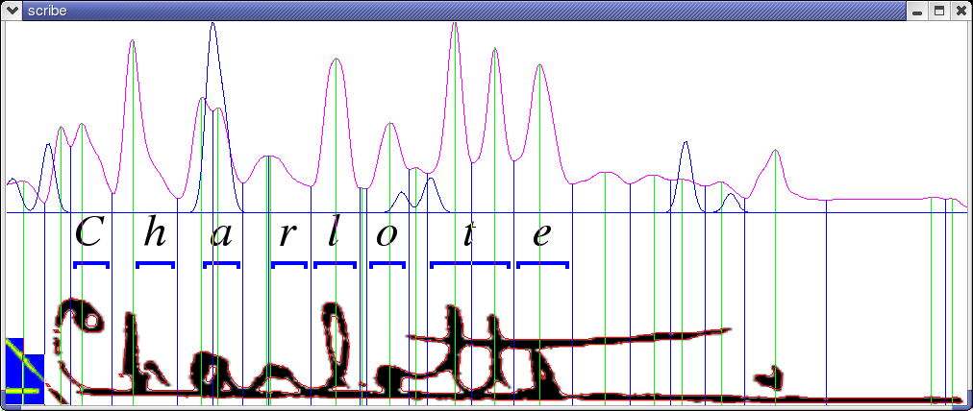
Results (3)

Slide 19
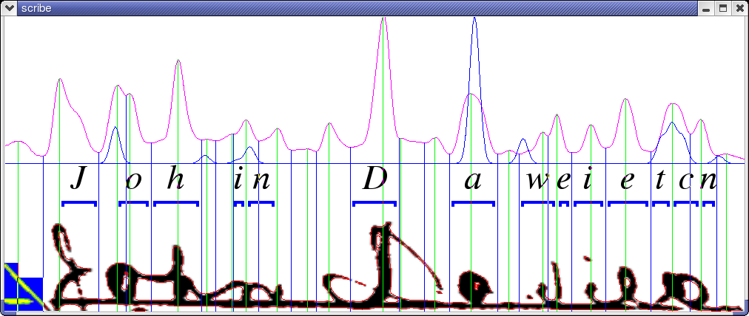
Results (4)
In general: results even worse – system only
worked well on words it was specifically trained on

Slide 20
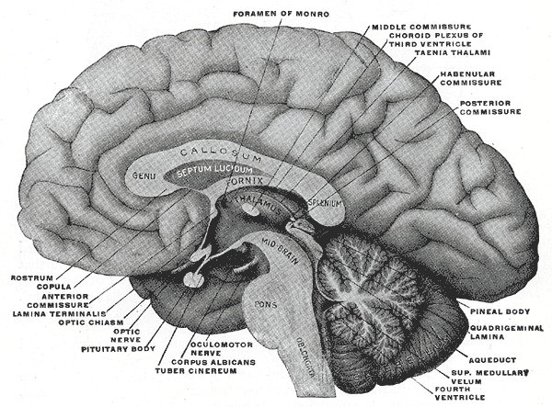

The Human Brain's
Visual System
Retina

Slide 21
The Human Brain's
Visual System
Angular edge detectors
Retina

Slide 22
The Human Brain's
Visual System
Line / curve detectors
... ... ...
Angular edge detectors
Retina

Slide 23
The Human Brain's
Visual System
Feature detectors
Line / curve detectors
... ... ...
Angular edge detectors
Retina

Slide 24
The Human Brain's
Visual System
Lateral inhibition
Feature detectors
Feedback
Line / curve detectors
... ... ...
Angular edge detectors
Retina

Slide 25
The Human Brain's
Visual System
Letter / word shape recognizers
J
Lateral inhibition
Feature detectors
Feedback
Line / curve detectors
... ... ...
Angular edge detectors
Retina

Slide 26
The Human Brain's
Visual System
Joseph
Letter / word shape recognizers
J
Lateral inhibition
Feature detectors
Feedback
Line / curve detectors
... ... ...
Angular edge detectors
Retina

Slide 27
Conclusions
Handwriting recognition is important for genealogy...
...but it is hard
Current methods don't work very well...
...and they don't operate much like the human brain
Future work should focus on understanding the brain, and emulating it as much as possible, e.g. With:
  Hierarchical reasoning
  Feedback
  Lateral inhibition

Slide 28
Questions?
Luke Hutchison lukeh@email.byu.edu

